Slide 1

Unit 01.01.01
CS 5220:
COMPUTER COMMUNICATIONS
Evolution of Communication Networks
XIAOBO ZHOU, Ph.D.
Professor, Department of Computer Science

Slide 2
What is a Communication Network?
The equipment (hardware & software) and facilities that provide the basic communication service
Facilities
  Copper wires, optical fiber …
Communication
Network
Equipment
  Routers, servers, switches, …

Slide 3
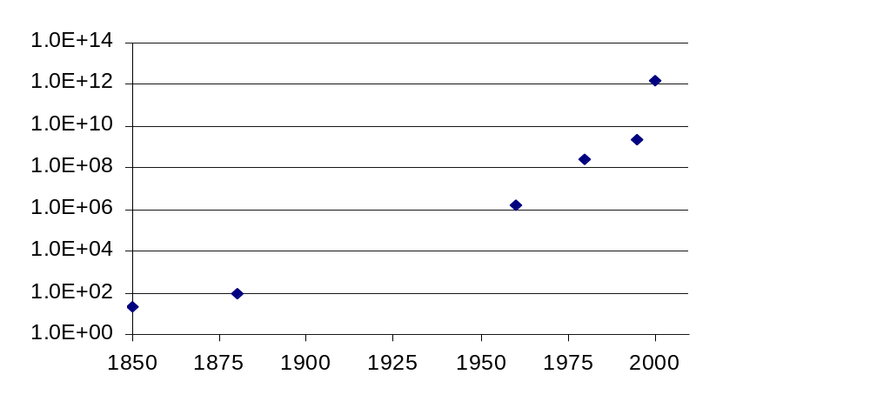
Network Architecture Evolution
?
Information transfer
per second
Telegraph
networks
Telephone
networks
Internet, Optical
& Wireless
networks
Next Generation Internet

Slide 4

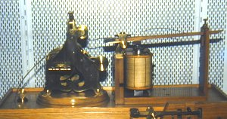
Telegraph Networks
Telegraph: a message is transmitted across a network using signals
  Drums, beacons, mirrors, smoke, flags, semaphores…
  Electricity, light

Slide 5
Digital Communications
Morse code converts text message in sequence of dots & dashes
Use transmission system designed to convey dots and dashes
 | Morse Code |  | Morse Code |  | Morse Code |  | Morse Code
A | · — | J | · — — — | S | · · · | 2 | · · — — —
B | — · · · | K | — · — | T | — | 3 | · · · — —
C | — · — · | L | · — · · | U | · · — | 4 | · · · · —
D | — · · | M | — — | V | · · · — | 5 | · · · · ·
E | · | N | — · | W | · — — | 6 | — · · · ·
F | · · — · | O | — — — | X | — · · — | 7 | — — · · ·
G | — — · | P | · — — · | Y | — · — — | 8 | — — — · ·
H | · · · · | Q | — — · — | Z | — — · · | 9 | — — — — ·
I | · · | R | · — · | 1 | · — — — — | 0 | — — — — —

Slide 6
Electric Telegraph Networks
Electric telegraph networks exploded
  Message switching & Store-and-Forward operation
  Key elements: Framing, Multiplexing, Addressing, Routing, Forwarding
Message
Message
Message
Source
Message
Switches
Destination

Slide 7
Elements of Telegraph Networks
Digital transmission
  Text messages converted into symbols
  Transmission system designed to convey symbols
Multiplexing
  Framing needed to recover text characters
Message Switching
  Messages contain source & destination addresses
  Store-and-Forward: messages forwarded hop-by-hop across network
  Routing according to destination address

Slide 8
Bell’s Telephone
Alexander G. Bell (1876) working on harmonic telegraph to multiplexing discovered voice signals can be transmitted directly
  Microphone converts voice pressure variation into analogous electrical signal
  Loudspeaker converts electrical signal back into sound
Basic telephone service involves two-way, real-time transmission of voice signals across a network
  Signaling required to establish a call
Signaling + voice signal transfer

Slide 9
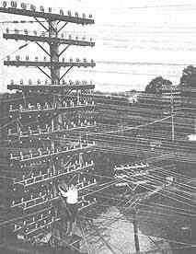
The N² Problem
Initially, p2p direct communications - for N users to be fully connected directly
  Requires too much space for cables
  Inefficient & costly since connections not always on
1
N
2
N = 1000
N(N – 1)/2 = 499500
. . .
4
3

Slide 10

Circuit Switching is Connection-oriented
Patchcord panel switch invented in 1878
Operators connect users on demand
  Establish circuit to allow electrical current to flow from inlet to outlet
Only N connections required to central office
1
N
N – 1
2
3

Slide 11
Hierarchical Tele-Network Structure
End-to-end connection requires collaborative switching
switching
CO = central office
Toll
Tandem
trunks
Tandem
CO
CO
CO
CO
CO
last mile

Slide 12
Elements of Telephone Networks
Digital transmission & switching
  Digital voice; Time Division Multiplexing
Circuit switching – Connection oriented
  User signals for call setup and tear-down
  Route selected during connection setup
  End-to-end connection across network
  Signaling coordinates connection setup
Hierarchical Network Structure
  Decimal numbering system
  Hierarchical structure; simplified routing; scalability

Slide 13
Network Architecture Evolution
Telegraph Networks
  Message switching & store-and-forward
Telephone Networks
  Circuit Switching and connection oriented
Computer Networks and the Internet
  Packet switching
  Virtual circuit switching
Next-Generation Internet
  ???

Slide 14
Summary of the Lesson
History often repeats itself

